Slide 1
Loma Ridge Enzyme Activity – meeting 1
Monday January 31, 2022
8 AM PST

Slide 2
Agenda
Recap of my thesis
My vision for the manuscript
Framework for analysis
Open discussion
Roles & deadlines

Slide 3
Thesis findings
No change in enzyme amounts across drought and ambient treatments
Amounts of enzymes BG, CBH, NAG are higher in grassland ecosystem

Slide 4
Thesis findings
No change in enzyme amounts across drought and ambient treatments
* 0.01 <= p < 0.05; ** 0.001 <= p < 0.01; *** p < 0.001
Enzyme | Time | Vegetation | Ppt | Time x Ppt | Time x Vegetation | Vegetation x Ppt | 3-way
AP
AG | **
BG |  | ***
BX
CBH | *** | *** |  |  | ***
LAP
NAG | *** | *** |  |  | ***
PPO |  | ** |  |  |  |  | *

Slide 5
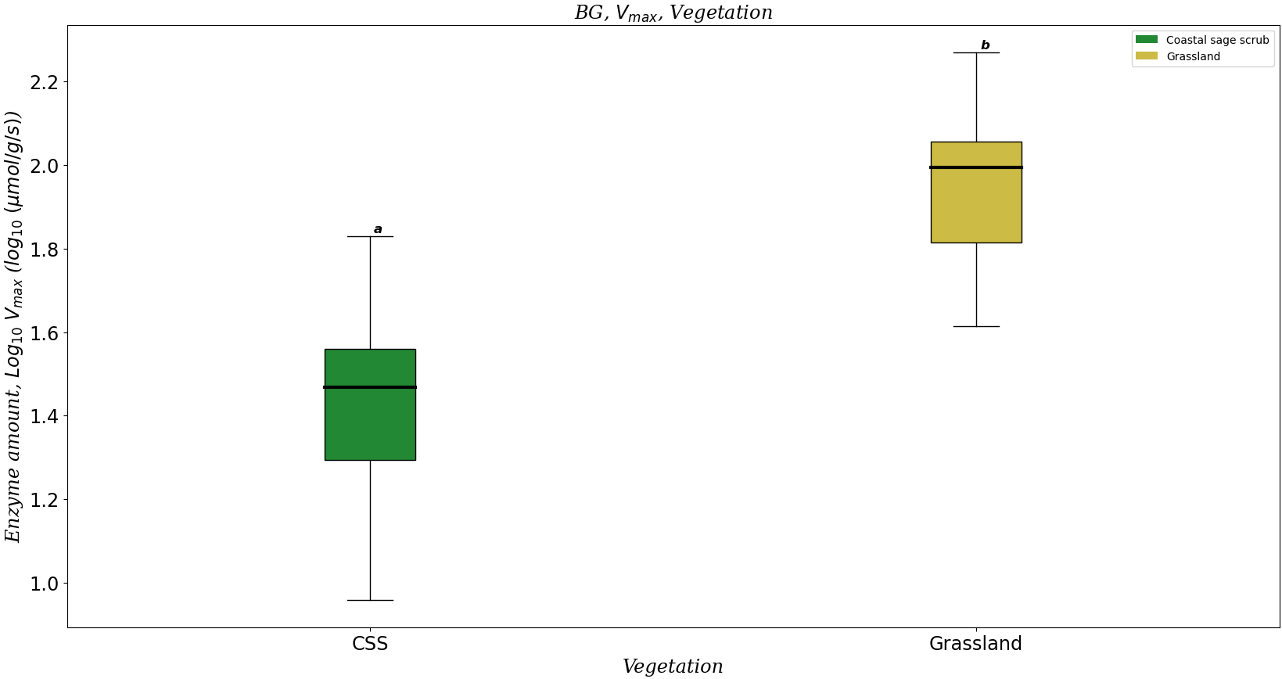
BG Vmax across ecosystems

Slide 6
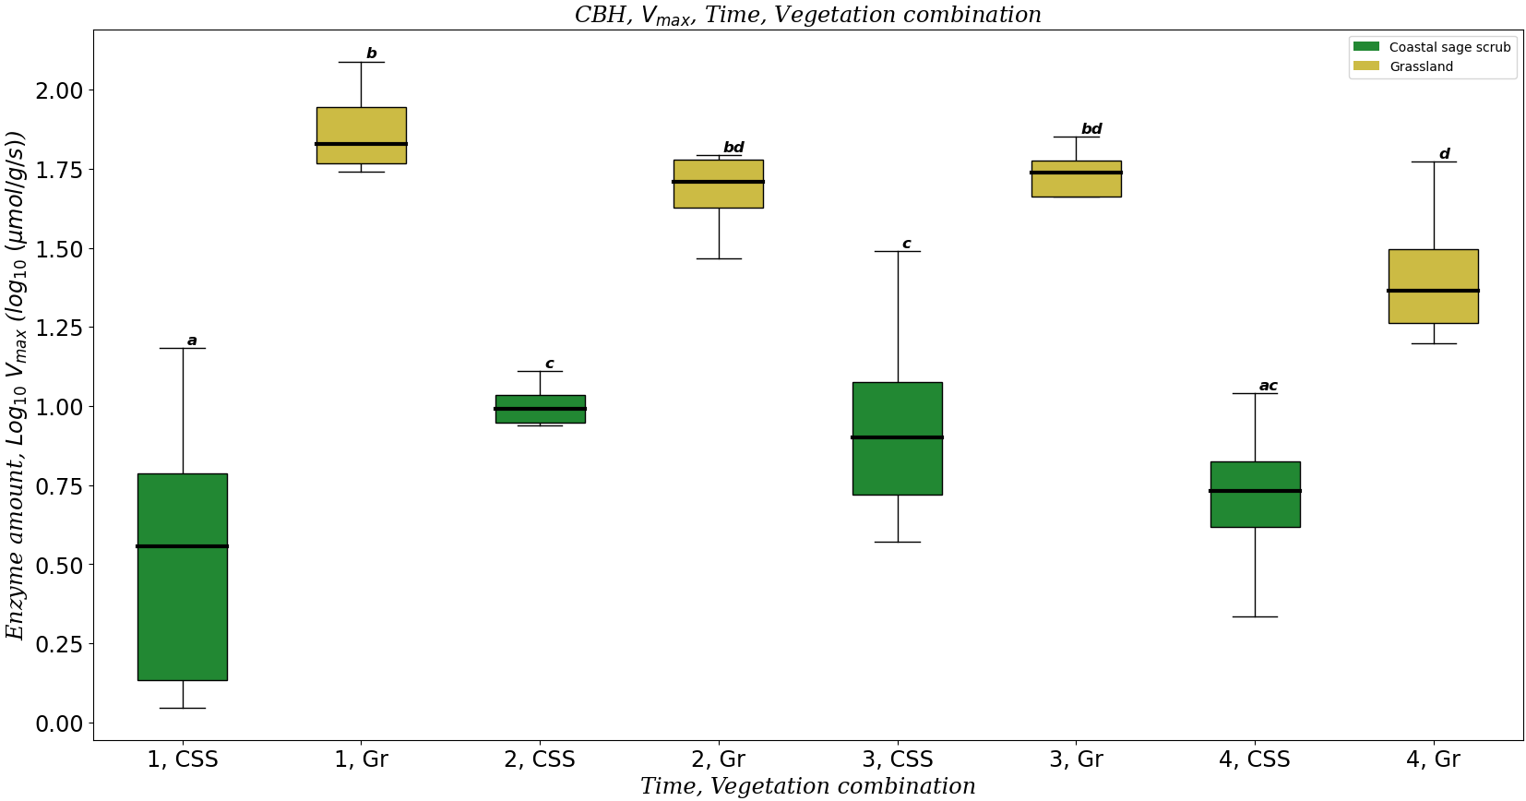
CBH Vmax across ecosystems

Slide 7
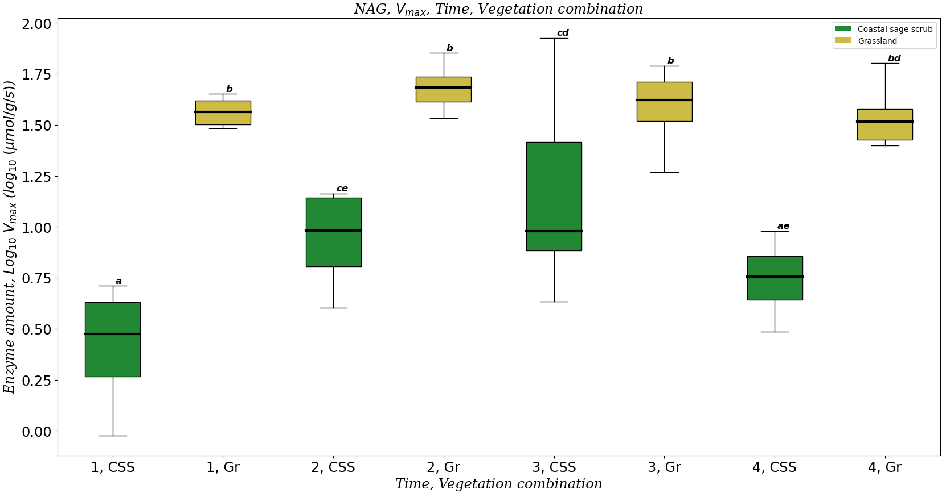
NAG Vmax across ecosystems

Slide 8
Thesis limitations
Looks at overall enzyme pools rather than specific enzyme pools (e.g. adsorbed enzymes vs enzymes in soil solution)
Can’t determine mechanism(s) for why drought doesn’t influence enzyme activity
Can’t link enzyme activity with decomposition rates

Slide 9
My Vision for the manuscript
Link a microbial trait (enzyme activity) with biogeochemistry (decomposition rates)
Investigate how drought and ecosystems influence specific enzyme pools and decomposition rates

Slide 10
Things to investigate
Drought
Litter chemistry
Enzyme pools (active & inactive)
Decomposition rates
Mass loss
Enzyme activity
Ecosystem
CAZyme counts

Slide 11
Framework
Adsorbed onto leaf litter (inactive)
Soil solution (active)
Adsorption
Production
Desorption
Proteolytic breakdown
Alster et al. 2013; Burns et al. 2013; Geissler et al. 2011

Slide 12
Framework
Effect of active enzymes determined by mass loss data
Inferred from enzyme activity data and CAZymes data
Adsorbed onto leaf litter (inactive)
Soil solution (active)
Adsorption
Production
CAZymes data
Desorption
Proteolytic breakdown
Enzyme activity data determine overall enzyme amount of system

Slide 13
Open discussion
Determining roles can help us determine deadlines
Ashish mentioned special edition of the Microbiology journal
To note: I’m very hesitant with the end of March deadline

Slide 14
References
Alster, C. J., German, D. P., Lu, Y., Allison, S. D. (2013). Microbial enzymatic responses to drought and to nitrogen addition in a southern California grassland. Soil Biology & Biochemistry, 64, 68-79.
Burns, R. G., DeForest, J. L., Marxsen, J., Sinsabaugh, R. L., Stromberger, M. E., Wallenstein, M. D., Weintraub, M. N., Zoppini, A. (2013). Soil enzymes in a changing environment: Current knowledge and future directions. Soil Biology & Biochemistry, 58, 216-234.
Geisseler, D., Horwath, W. R., Scow, K. M. (2011). Soil moisture and plant residue addition interact in their effect on extracellular enzyme activity. Pedobiologia – International Journal of Soil Biology, 54, 71-78.

